Slide 1
Our Future Career Opportunities in Cumbria
Jo Tate – Enterprise Co-ordinator

Slide 2
Aims of the presentation
To introduce LMI to you
To develop your understanding of the labour market in Cumbria
To highlight how the world of work has changed
To identify growth areas including (STEM careers)
To signpost you to where you can find labour market information to help you on your career journey.

Slide 3
Cumbria is a great place to live, work and invest.
The Lake District is the UK’s most visited National Park and is now a World Heritage Site.
But Cumbria is not just rural. Cumbria is a modern, exciting and a connected place.
Cumbria is an amazing place to work.
The area offers a wide variety of industries including include Nuclear & Clean Energy, Advanced Manufacturing, Food Production, Tourism and Hopitality, Health & Social Care, Construction, Logistics, Creative Cultural & Digital Arts and Media and Professional Services.

Slide 4
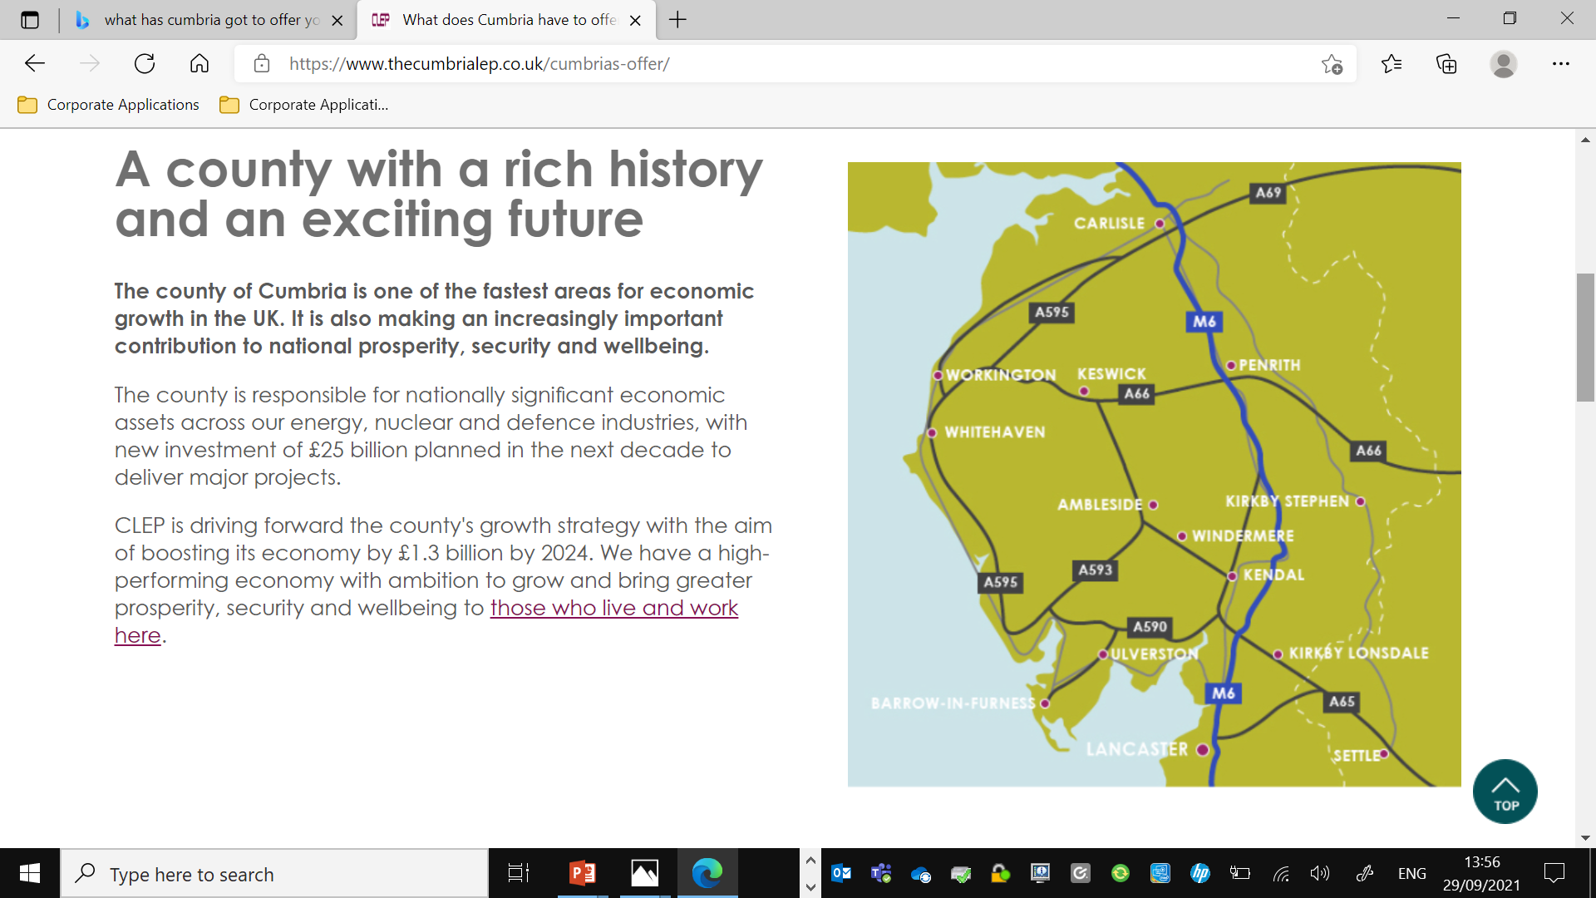
Cumbria is a great place to live, work and invest.

Slide 5
The world of work
The world of work is continually changing, particularly as a result of the Covid-19 pandemic, and you may wonder what future employment opportunities will look like .
Will people still be working from home in the future?
Brexit – The labour market has changed and some funding has disappeared.
Looking at future trends, the area around you and the different ways in which we work can help you plan your future career.
This is called Labour Market Information.

Slide 6
What is the “labour market”?
Labour market information can tell you:
The number of people in certain types of jobs.
Which industries are recruiting and where they are located.
What jobs and skills employers are looking for.
Growing or declining job areas and general employment trends.
When thinking about career ideas it is useful to consider what is happening in the labour market and to have ‘back up’ ideas.

Slide 7
Why do I need to know about that?
Knowing certain information makes decision making easier
It answers questions such as:-
Will I need to go to university?
How much will I earn?
What would I do each day?

Slide 8
Here are just a few new and emerging jobs which didn’t even exist 10 years ago:
Uber Driver
Social Media Influencer
Driverless Car Engineer
Drone Operator
App Developer
Zumba Instructor
Podcast Producer
Big Data Scientist
Artificial Intelligence Engineer
Contact Tracer
Digital Marketing Specialist

Slide 9
How is the World of Work Changing ?

Slide 10
New technology is being developed all the time.
How can it affect jobs? | Think about it | Which job areas will be important?
New technology is the main reason for old jobs disappearing. | Self-service machines. Robots on production lines. Greater demand for people with IT, electrical and engineering skills to fix them and develop new ones. | Electronics, Robotics, Engineering, Creative and media, ICT and data, Aerospace and Cyber security.

Slide 11
People are living longer.
How can it affect jobs? | Think about it | Which job areas will be important?
People will need more health and social care. | More care needs = More health and social care professionals. Increased demand for medical research. | Health care, Social care, Bioscience, Pharmacology and Leisure.

Slide 12
The skills of people around the world are improving
How can it affect jobs? | Think about it | Which job areas will be important?
There is more competition from the rest of the world. | China and India both have more than twice as many graduates as the UK. Apprenticeship programmes in countries like Germany are highly regarded and well established. We cannot afford to be left behind it is a competitive market. | Education, Science, Engineering, Creative and media (including gaming), Manufacturing, ICT and Finance.

Slide 13
We must preserve our environment.
How can it affect jobs? | Think about it! | Which job areas will be important?
More research into saving energy and developing greener energies. | If we all start driving electric cars we will need skilled mechanics to maintain them. Making processes and products more efficient and sustainable. Reduce pollution. | Engineering (including motor vehicle), Chemical processing, Recycling, Agriculture, Energy and Innovation

Slide 14
People are changing how they spend their money, especially to support their wellbeing.
How can it affect jobs? | Think about it | Which job areas will be important?
Demand for services such as catering, fitness, health spas and gaming. | Some farms are turning to tourism as well as farming. More overseas visitors. More hotels offering spa facilities. | Health and Beauty, Sport and Leisure, Hospitality and Tourism, Creative and Media, Sales and Marketing.

Slide 15
What About Qualifications?
The majority of jobs available now and in the future require at least level 2 or level 3 qualifications but over 40% of UK jobs will be for graduates.
Why? Because the UK needs to compete with the rest of the world!
What does this mean to you?
The more qualifications you have, the more jobs you can apply for. Most employers want someone who has at leave five good GCSEs including English and Maths, and often Science too.
If you have these and some work experience, this provides the best foundations to move into your chosen career.

Slide 16
STEM Jobs – A Growth Area?
What is STEM?
STEM stands for Science, Technology, Engineering and Maths.
Employers value the skills you develop in STEM subjects and careers.
Why? Because there are going to be more skilled jobs available in these areas in the future.
Being creative is also important, to be innovative in solving workplace challenges.

Slide 21
Cue Video

Slide 22
STEM Video
Where STEM Can Take You | STEM

Slide 23
Average Salaries
The average UK salary for full time jobs in 2020 was £38,600
The average Cumbrian salary for full time jobs in 2020 was £35,750
The best paid occupation in the UK was Chief Executive with an average salary of £126,600
Other jobs listed in the UK’s best paid occupations in 2020 were Aircraft Pilots & Flight Engineers, Marketing & Sales Directors, Legal Professionals and Financial Managers.

Slide 24
The top 10 most advertised jobs in 2020 are listed below
1
Nurse
1,636
Average advertised salary £37,950
2
Care worker
1,605
Average advertised salary £21,144
3
Admin
605
Average advertised salary £23,585
4
Managers
557
Average advertised salary £37,879
5
Sales
526
Average advertised salary £33,860
6
Domestic
495
Average advertised
salary £20,517
7
Customer Service
493
Average advertised salary £22,178
8
Driver
472
Average advertised salary £27,493
9
Programmer / Software Developer
462
Average advertised salary £52,944
10
Engineering Professional
452
Average advertised salary £62,055

Slide 25
The 10 employers below advertised the most jobs in Cumbria in 2020
1 | National Health Service | 2,203 job postings
2 | Cumbria County Council | 635 job postings
3 | BAE Systems | 547 job postings
4 | Vida Education | 199 job postings
5 | Cera Care | 197 job postings
6 | Walgreens Boots Alliance | 171 job postings
7 | Phoenix Care Staff Limited | 133 job postings
8 | Creative Support | 131 job postings
9 | Center Parcs | 115 job postings
10 | M2 Education Limited | 104 job postings

Slide 26
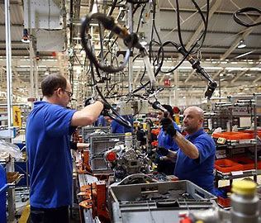
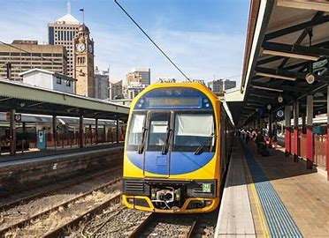
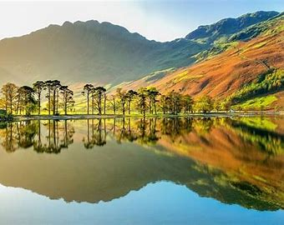
The top 10 Growth Areas/Sectors in Cumbria
Health Care
Social Care
Advanced Manufacturing
Nuclear & Clean Energy
Construction
Tourism & The Visitor Economy
Transport & Logistics
Professional Services
Creative & Cultural
Rural
Professional Services

Slide 27
Activity
Can you match the Cumbrian Employers on the next slide to the sectors on the previous slide ?
There is at least 1 for each sector some have more .
(3 minutes to do it )

Slide 28
Employers in Cumbria
Notes:
2 Sisters (Cavrays) – Looking for entrepreneurial staff to drive change and new ideas to become a leader in the food industry – if want a career in Food Manufacturing.
BAE, Barrow – employ 5,200 staff
Sellafield – 9,800 staff – largest ‘private’ employer in the county
Nestle – 8,000 people over 20 sites including Dalston (cappuccino & Coffee Mate products) York, Halifax (Polo, Quality Street & Kitkat), Liverpool. Brands include Kitkat (chocolate) & Purina – pet food so jobs can include Vet Advisers, Sales Assistants, Shift Engineers etc
Pirelli – 5th largest tyre manufacturer in the world. In Carlisle Pirelli make tyres for Audi, Jaguar Land Rover, Mercedes, Porsche & Volvo. Currently expanding
Innovia, Wigton – Produce polypropylene and cellulose films – think £5 and £10 notes, Quality Street wrappers – made of paper to look like plastic – fully biodegradable
Crown Bevcan – Metal Box – employ 335 and produce 1,400 can per minute for beer, cider and soft drinks
Pladis – formerly McVities – In Carlisle make ginger nuts, fruit shortcake and Carrs Table Water biscuits
Asda – 180,000 employees known as ‘colleagues’ in stores, HR and distribution centres
Heinz – factory in Kendal – Baby foods
NHS – one of the largest employer in Cumbria – has over 350 different job roles including psychiatrists, physiotherapists, HR staff, cleaners, porters, doctors, dentists, nurses
Cumbria County Council – largest employer in Cumbria – includes schools, libraries, youth services, social services, highway maintenance, waste disposal, emergency planning, consumer protection, town & country planning
Many of these firms are local, national and international – need to do your research.

Slide 29
Cue Timer

Slide 30
The top 10 Growth Areas/Sectors in Cumbria
Health Care
Social Care
Advanced Manufacturing
Nuclear & Clean Energy
Construction
Tourism & The Visitor Economy
Transport & Logistics
Professional Services
Creative & Cultural
Rural
Professional Services

Slide 31
Where can you find Labour Market Information?
Careers Fairs
Open days and taster sessions at colleges and training providers
Local newspapers
Social Media
Leaflets /booklets produced by sectors or local employers
Workplace visits
Work experience/placements
Ask people .

Slide 32
Other Information
Cumbria has a lot to offer young people – bright careers with long-term prospects in a fantastic place that can offer both inspiration and excitement
Good transport links from Carlisle via M6 to Glasgow, North West and the Midlands
Can get to London in 3.5 hours by rail
Notes:
Do you know what you want to do? Think about it before you choose your GCSE subjects!
If you want to study at A level you may need to take that subject at CGSE level first
You may need to consider working further away from home – depending on what career path you want to follow
Not all jobs will be available locally – think about this

Slide 33
Young people need to prepare for roles in an ever changing workforce
Over half the jobs that you will be doing in the future do not even exist today
To get the BEST jobs
You need:
The right exam results
A good attitude and Experience
Resilience
Positive Attitude

Slide 34
Activities
There is a quiz available in the activities zone that is linked to my workshop if you want to test your labour market knowledge.
Thankyou for your time- enjoy the rest of the careers fair.

Slide 35
Sources of information -The information included in this presentation is factual, reliable and valid and is sourced from :
Labour Insight (Burning Glass Technologies)
Annual Population Survey Dec 2020 (Office for National Statistics)
Mid-Year Population Estimates 2019 (Office for National Statistics)
Annual Survey of Hours & Earnings 2020 (Office for National Statistics
Local Economy Forecasting Model Mar 2021 (Cambridge Econometrics)
UK Business Counts 2020 (Office for National Statistics)
Business Register Employment Survey 2019 (Office for National Statistics)
Localities Data Cube 2019/20 (learner home geography) (Department for Education)

