Slide 1
BM3 Exploring Best Practice
Careers Advice and Guidance

Slide 2
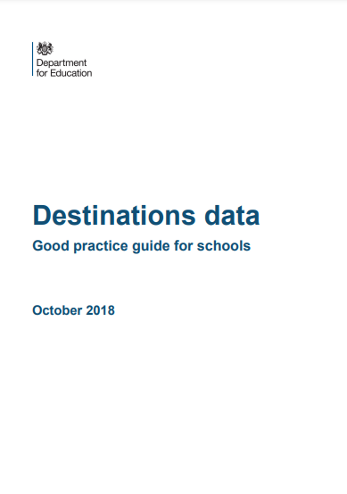
Baker Clause supporting students to understand the full range of education and training options

Slide 3
Gatsby Benchmarks
A stable careers programme
Learning from careers and LMI
Addressing the needs of each pupil
Linking curriculum learning to careers
Encounters with employers/employees
Experiences of workplaces
Encounters with further and higher education
Personal guidance

Slide 4
Gatsby Benchmarks
A stable careers programme
Learning from careers and LMI
Addressing the needs of each pupil
Linking curriculum learning to careers
Encounters with employers/employees
Experiences of workplaces
Encounters with further and higher education
Personal guidance

Slide 5
BM3
LLT is made up of two schools:
Queen Elizabeth School 11 to 18
QEStudio School 14-19
QEStudio first opened in 2017, first leavers were in 2019

Slide 6
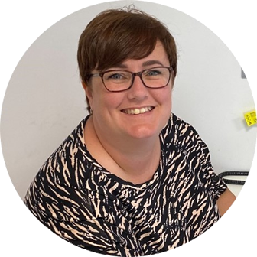
Sarah Womersley Level 6 trained in Careers Guidance and Development
LLT Careers Coordinator

Slide 7
Destinations Data
Confidence

Slide 8
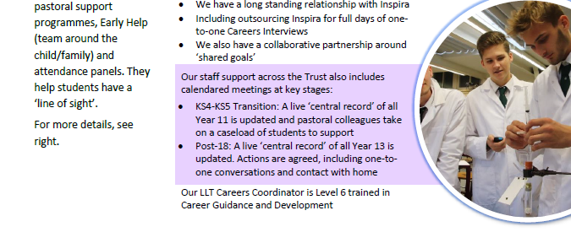
Destinations Update ‘Our Strengths’ correlate to the other Gatsby Benchmarks

Slide 9
Next steps…

Slide 10
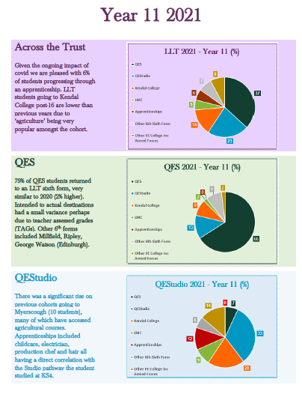
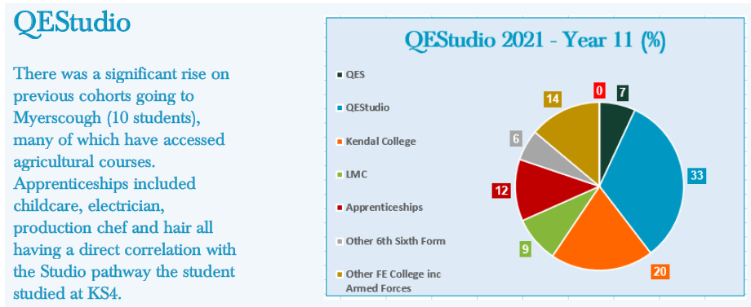
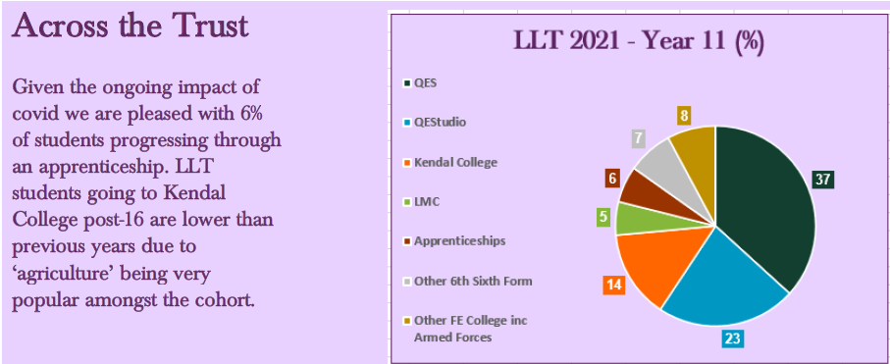
Sound bites Script Agreed destinations
Destinations Data 2021

Slide 11
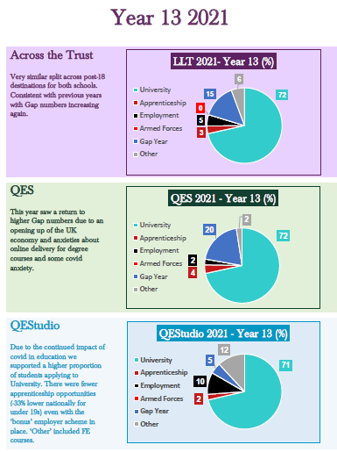
Year11 Year13 2019 2020 2021
Destinations Data 2021

Slide 12
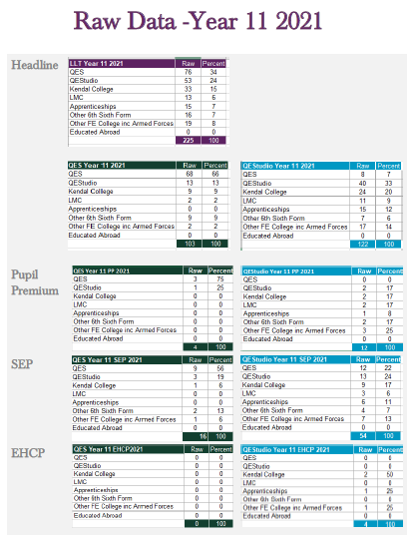
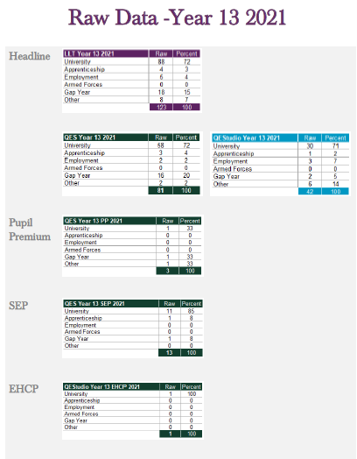
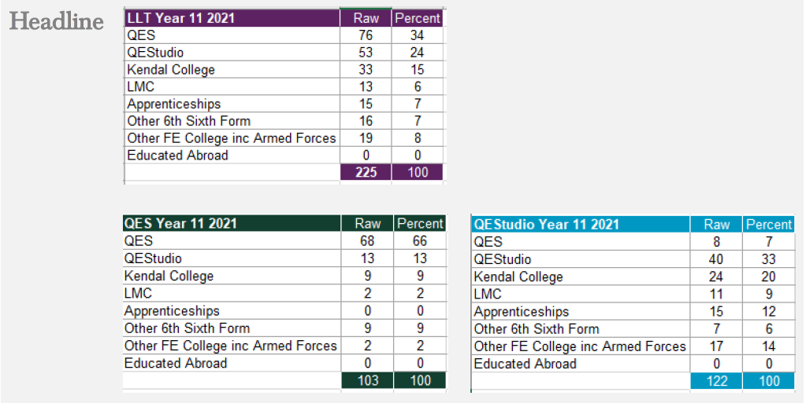
Headline Pupil Prem SEP EHCP
Raw Data 2021

Slide 13
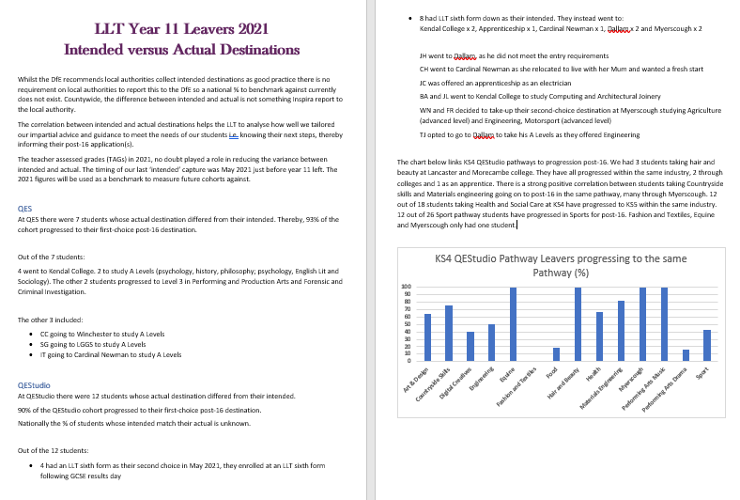
Impact measure?
Intended versus Actual Destinations

Slide 14
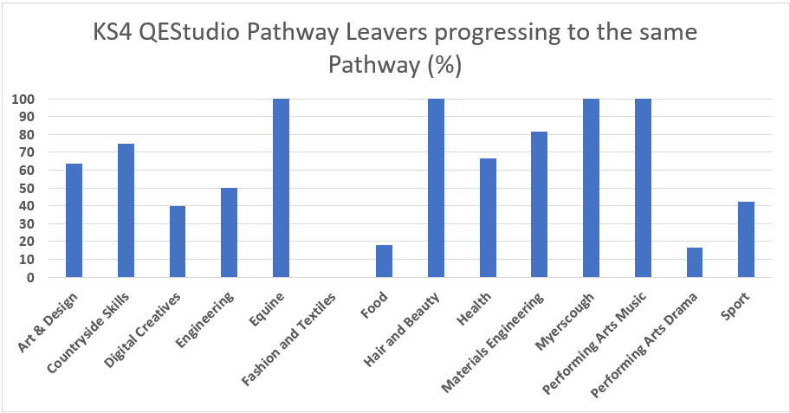
Correlation
Intended versus Actual Destinations

Slide 15
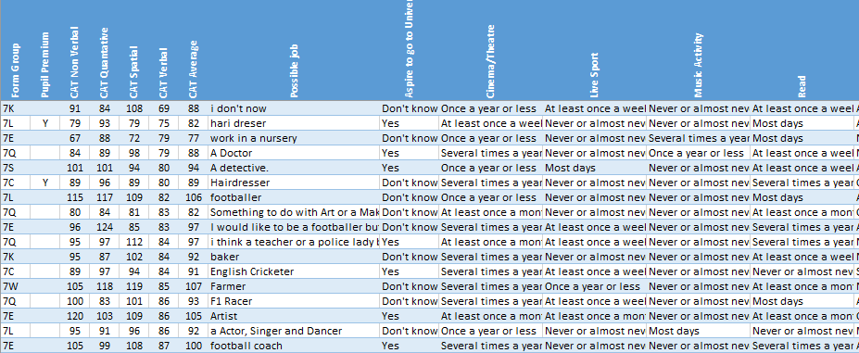
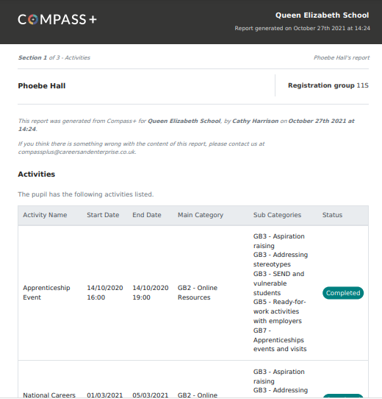
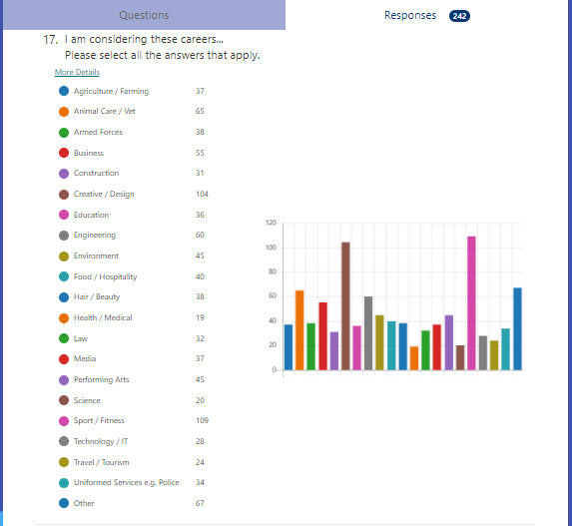
Aspirations survey Compass+ Exit survey (feedback)
Addressing the needs of each pupil

Slide 16
Addressing the needs of each pupil

Slide 17
Addressing the needs of each pupil

Slide 18
Gatsby Benchmarks
A stable careers programme
Learning from careers and LMI
Addressing the needs of each pupil
Linking curriculum learning to careers
Encounters with employers/employees
Experiences of workplaces
Encounters with further and higher education
Personal guidance

Slide 19
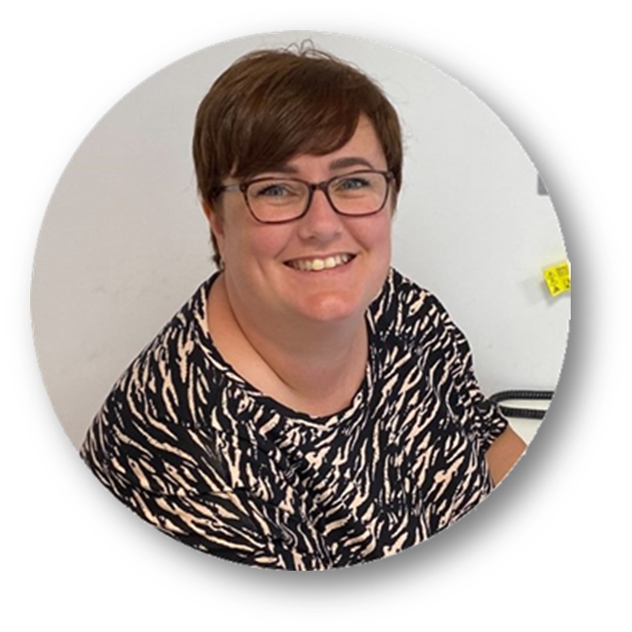
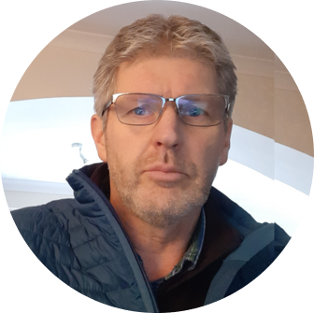
Have had at least two interviews with a professional careers adviser by the end of year 13
Personal guidance
So far this academic year :
252, 1-2-1 careers appointments with Sarah
34, 1-2-1 careers appointments with Chris
72, sixth form 1-2-1 careers appointments

Slide 20
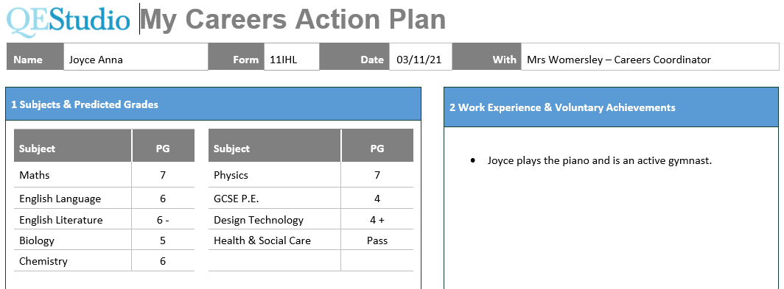
Action Plan

Slide 21
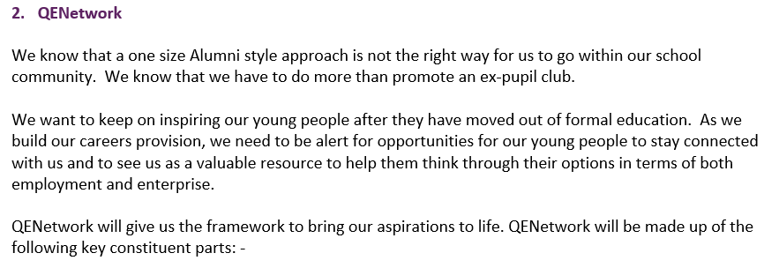
QENetwork QEConnect QEEnterprise QEInspiration QEUni QEApprenticeship QECommunity

Slide 22
Areas for Development
1
Gathering intended destinations
2
Streamlining 3-year data
3
QENetwork
4
Exit surveys

Slide 23
Thank You!

