Slide 1
Labour Market Information
Year 9 Parents Evening
Jo Tate – Enterprise Co-ordinator
Notes:
Context info – LMI is delivered in schools to meet GBM 2 – parents also need to be aware hence this presentation

Slide 2
Aims of the presentation
To develop your understanding of the labour market in Cumbria
To highlight how the world of work has changed
To identify the growth areas in Cumbria
Notes:
Changing jobs market in current economic situation – young people need to be aware of all opportunities available to them so that they are able to make informed choices about what career options are right for them .

Slide 3
What is the “labour market”?
Labour market information can tell you:
The number of people in certain types of jobs.
Which industries are recruiting and where they are located.
What jobs and skills employers are looking for-this changes depending on the market .
Growing or declining job areas and general employment trends.
Notes:
Mention top 10 skills – Initiative- Numeracy-Organisation-Working under pressure- Able to adapt,Communication – Team work- negotiation- Problem solving IT .

Slide 4
What about Cumbria?

Slide 5
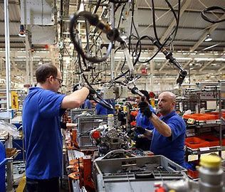
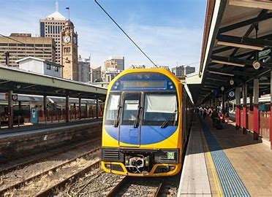
The top 10 Growth Areas/Sectors in Cumbria
Health Care
Social Care
Advanced Manufacturing
Nuclear & Clean Energy
Construction
Tourism & The Visitor Economy
Transport & Logistics
Professional Services
Creative & Cultural
Rural
Professional Services

Slide 6
Employment opportunities in Cumbria
There are over 23,000 small, medium and large businesses in Cumbria.
Below are just a few – how many of these have you heard of?

Slide 7
Barrow Specific information (data from (ONS) October 2022)
In Barrow there are 2,839 active businesses (with a primary trading address in location)
Many of these are Small or medium sized businesses and some will be micro businesses .
Strong emphasis on Engineering and Advanced Manufacturing but there are lots of opportunities across the other sectors as well.
Inspira and the National Careers Service have up to date information about job opportunities.
We will be launching a new resource (U-Explore Cumbria) very soon to showcase LMI across Cumbria that will be accessible to parents and students .

Slide 8
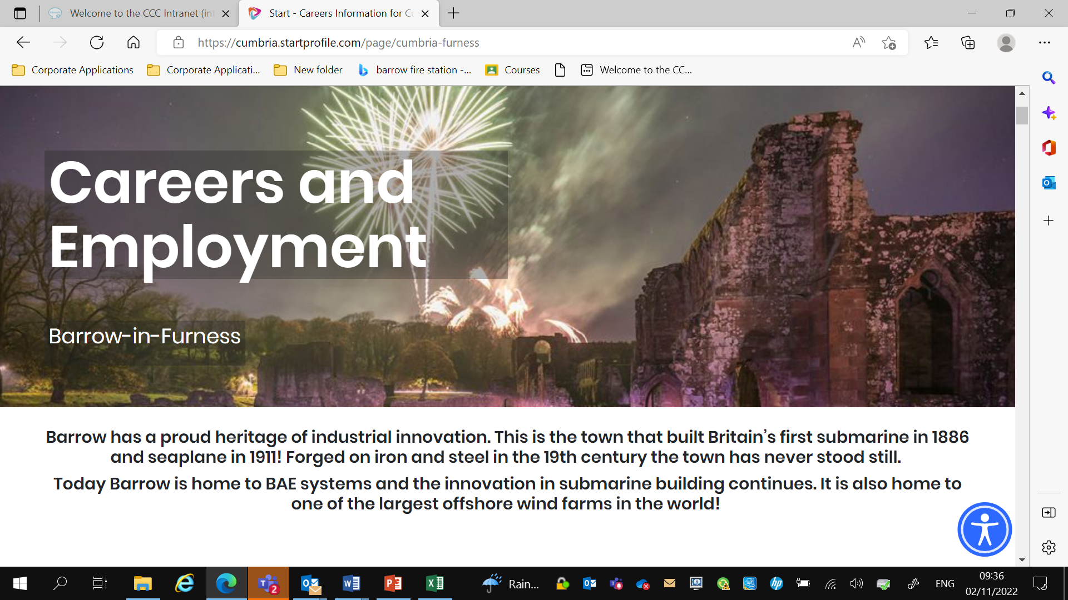

Slide 9
Learning from Career and Labour Market Information
Notes:
All are available on my stand tonight .

Slide 10
Build your skills!!
Research suggests that you may have 10 – 15 different jobs throughout your working lives – and many people move between sectors and jobs roles.
This means developing transferable skills, such as communication skills and team work skills, is really important.

Slide 11
Why is this important?
It is important that you are aware of the jobs which are growing or declining as trends change this might affect the career choices you make.

Slide 12
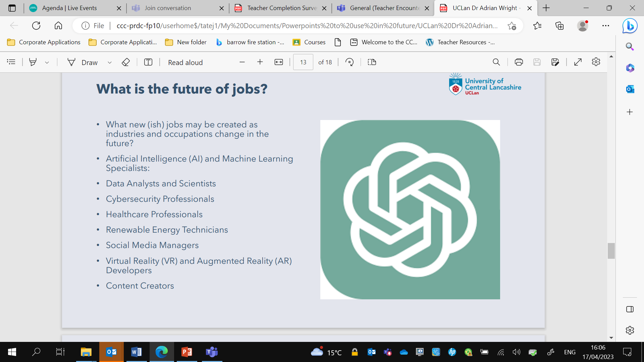

Slide 13
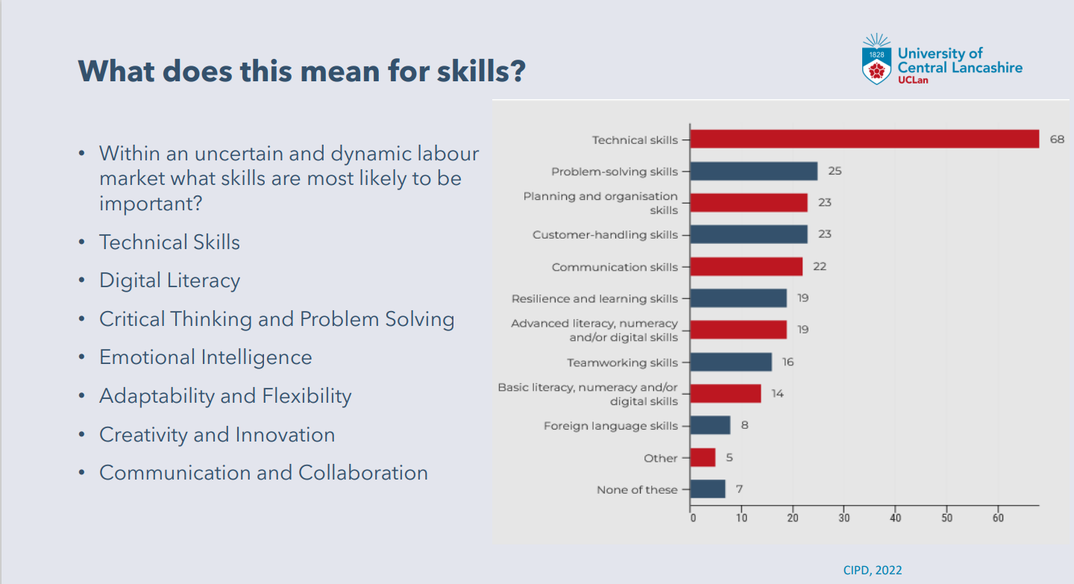

Slide 14
How do your GCSE Options relate to your career choices?

Slide 15
Thank you so much for your time
If you want to get in touch please contact me on jo.tate@thecumbrialep.co.uk

