Slide 1


Cumbria Labour Market Information
Activity for Key Stage 4&5

Slide 2
Aims of the presentation
To develop your understanding of the labour market in Cumbria
To identify the growth areas in Cumbria
To match the Cumbria employers to the growth sectors

Slide 3
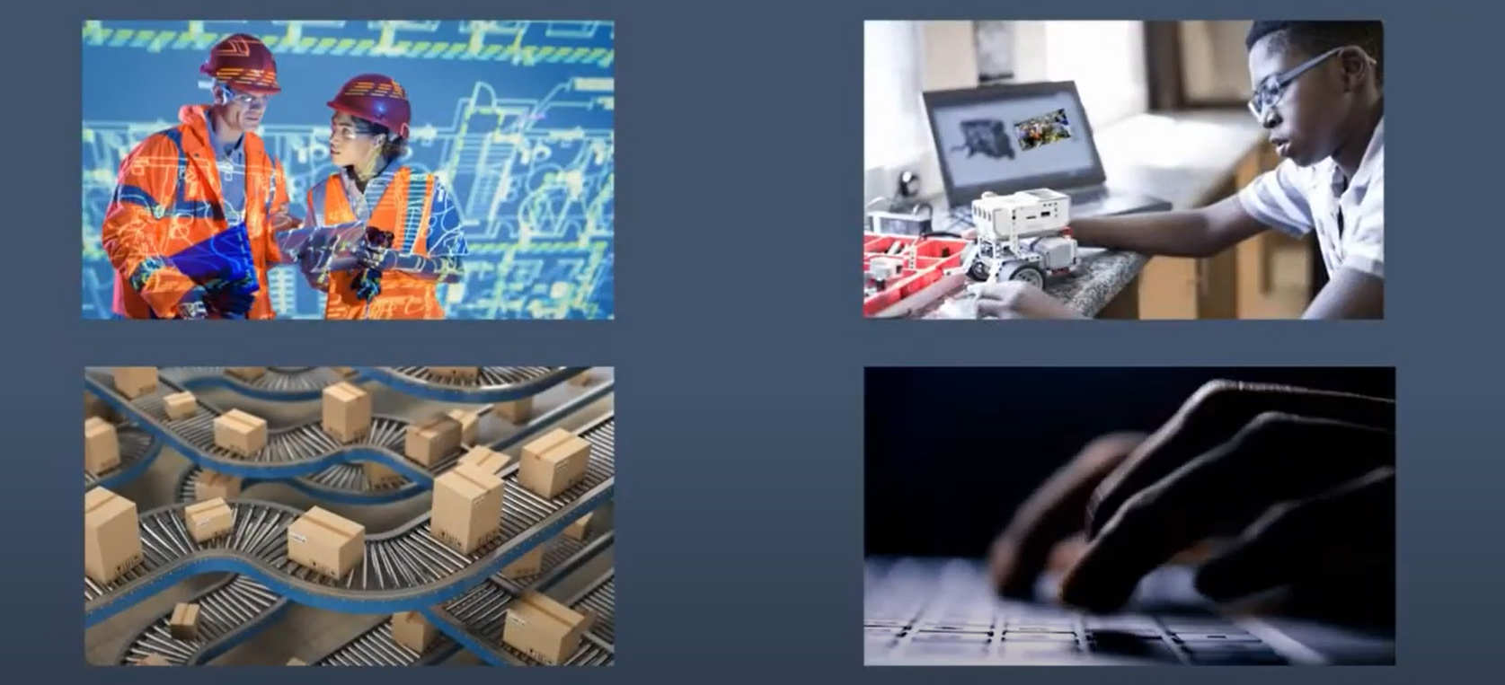
Labour Market Information – What is it ?

Slide 4
What is the “labour market”?
Labour market information can tell you:
The number of people in certain types of jobs.
Which industries are recruiting and where they are located.
What jobs and skills employers are looking for.
Growing or declining job areas and general employment trends.
When thinking about career ideas it is useful to consider what is happening in the labour market and to have ‘back up’ ideas.

Slide 5

Why do I need to know about that?
Knowing certain information makes decision making easier
It answers questions such as:-
  Will I need to go to university?
  How much will I earn?
  What would I do each day?

Slide 6
Demand versus Supply
Prices change according to the demand for goods.
This is the same in the jobs market –
Some skills and qualifications are in demand so employers will pay people more who have these.
Some skills and qualifications are not needed as much anymore so demand is reduced .
This is called Supply and Demand and this has a big impact on the jobs market.

Slide 7






What about Cumbria?

Slide 8


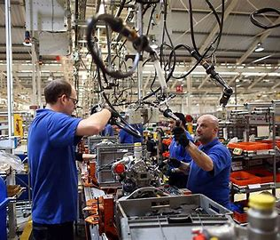


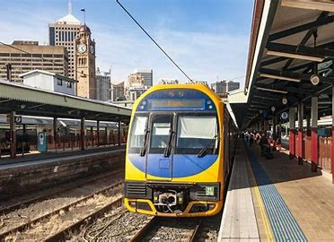




The top 10 Growth Areas/Sectors in Cumbria
Health Care
Social Care
Advanced Manufacturing
Nuclear & Clean Energy
Construction
Tourism & The Visitor Economy
Transport & Logistics
Professional Services
Creative & Cultural
Rural
Professional Services
Notes:
Can they name 2 Cumbrian businesses for each sector ?

Slide 9
The top 10 Growth Areas/Sectors in Cumbria
Health Care
Social Care
Advanced Manufacturing
Nuclear & Clean Energy
Construction
Tourism & The Visitor Economy
Transport & Logistics
Professional Services
Creative & Cultural
Rural
Professional Services

Slide 10




















Employers in Cumbria
Notes:
2 Sisters (Cavrays) – Looking for entrepreneurial staff to drive change and new ideas to become a leader in the food industry – if want a career in Food Manufacturing.
BAE, Barrow – employ 5,200 staff
Sellafield – 9,800 staff – largest ‘private’ employer in the county
Nestle – 8,000 people over 20 sites including Dalston (cappuccino & Coffee Mate products) York, Halifax (Polo, Quality Street & Kitkat), Liverpool. Brands include Kitkat (chocolate) & Purina – pet food so jobs can include Vet Advisers, Sales Assistants, Shift Engineers etc
Pirelli – 5th largest tyre manufacturer in the world. In Carlisle Pirelli make tyres for Audi, Jaguar Land Rover, Mercedes, Porsche & Volvo. Currently expanding
Innovia, Wigton – Produce polypropylene and cellulose films – think £5 and £10 notes, Quality Street wrappers – made of paper to look like plastic – fully biodegradable
Crown Bevcan – Metal Box – employ 335 and produce 1,400 can per minute for beer, cider and soft drinks
Pladis – formerly McVities – In Carlisle make ginger nuts, fruit shortcake and Carrs Table Water biscuits
Asda – 180,000 employees known as ‘colleagues’ in stores, HR and distribution centres
Heinz – factory in Kendal – Baby foods
NHS – one of the largest employer in Cumbria – has over 350 different job roles including psychiatrists, physiotherapists, HR staff, cleaners, porters, doctors, dentists, nurses
Cumbria County Council – largest employer in Cumbria – includes schools, libraries, youth services, social services, highway maintenance, waste disposal, emergency planning, consumer protection, town & country planning
Many of these firms are local, national and international – need to do your research.

Slide 11



















The top 10 Growth Areas/Sectors in Cumbria
Health Care
Social Care
Advanced Manufacturing
Nuclear & Clean Energy
Construction
Tourism & The Visitor Economy
Transport & Logistics
Professional Services
Creative & Cultural
Rural
Notes:
Discuss each sector ad give info about Cumbria current labour market picture

Slide 12


Slide 13
What do you need to know ?
Routes into the sectors
Skills & experience needed
Salary range
Progression opportunities
Local opportunities
Regional opportunities
National Opportunities
International opportunities
Could you be your own boss
Where should I look to find information
What is the work place culture of the company

Slide 14


Slide 15










